Slide 1


The characteristics of MOSFET BSC520N15NS3
Reporter：Nie Yongxin , She Xiaoliang , Chang Yi

Slide 2
The division of labour
Nie Yongxin: make the ppt & collect the data
Chang Yi: make the ppt & collect the data
She Xiaoliang: make the ppt & collect the data

Slide 3
Catalog
01.
Simulation Model
02.
Parameter Setup
03.
Simulation Results
04.
Analysis of the Results

Slide 4
01
Simulation Model

Slide 5

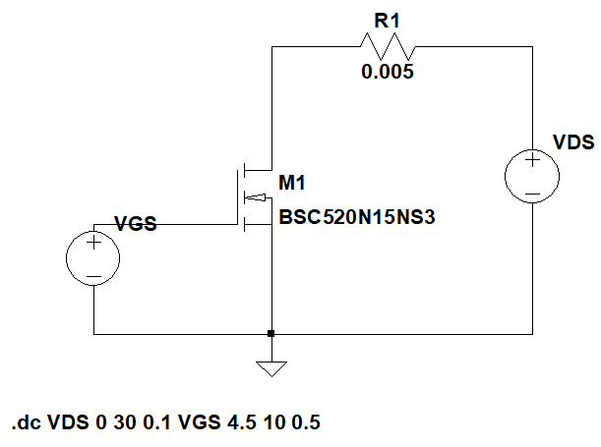
01
Simulation model 1
This model is established to find out the Output characteristics, Drain-source on resistance, Transfer characteristics and Switching waveform of MOSFET BSC520N15NS3 device. It includes a resistor, two voltage sources, a MOSFET BSC520N15NS3. The connection is shown on the ppt.

Slide 6
01
When VGS and VDS get a series of different values, we can get a bunch of curves of I_{D}, which is the Output characteristics.
When VGS and VDS get a series of different values, we can get a bunch of curves of I_{D},and then divide VDS by I_{D} to get R_{DS(on)} , which is Drain-source on resistance.
When VGS gets a series of different values, VDS is fixed and we simulate at different temperatures, we can get a bunch of curves of I_{D} , which is Transfer characteristics.
When we simulate Time-domain simulation, VGS being pulsating signal, we can get switching waveform correspondingly .

Slide 7
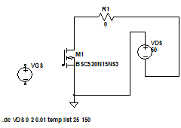
01
Simulation model 2
This model is established to find out the forward characteristics of reverse diode of MOSFET BSC520N15NS3 device.
It includes a resistor, one voltage source, a MOSFET BSC520N15NS3.

Slide 8
When VDS gets a series of different values at different temperatures, we can get different curves of I_{F}.

Slide 9
02
Parameter Setup

Slide 10
02
Parameter Setup
1
2
2 Drain-source on resistance
1 Output characteristics
VDS start value: 0 stop value: 3 increment: 0.1
VGS start value: 4 stop value: 10 increment: 0.5
R = 1
VDS start value: 0 stop value: 20 increment: 0.1
VGS start value: 5 stop value: 10 increment: 1
R = 1

Slide 11
3 Transfer characteristics
3
4
4 Forward characteristics
of reverse diode
VGS start value: 0 stop value: 8 increment: 0.8
T_{j} start value: 25 stop value: 150 increment: 125
VDS = 150
R = 1
VSD start value: 0 stop value: 2 increment: 0.1
T_{j} start value: 25 stop value: 150 increment: 125
R = 1

Slide 12
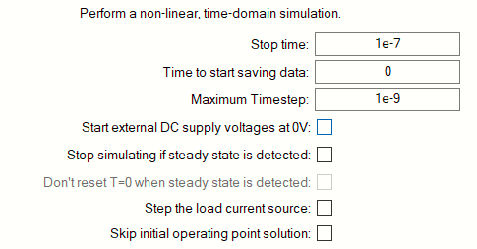
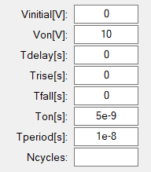
5
5 Switching waveform
VDC = 10
R = 1
VGS

Slide 13
03
Simulation Results

Slide 14
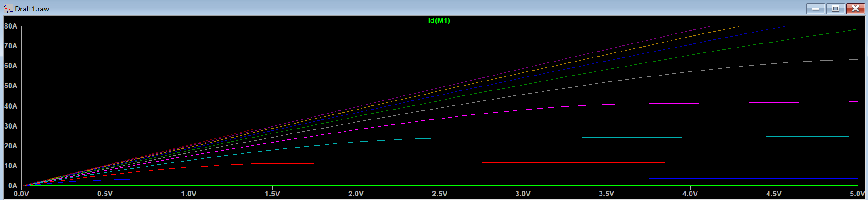
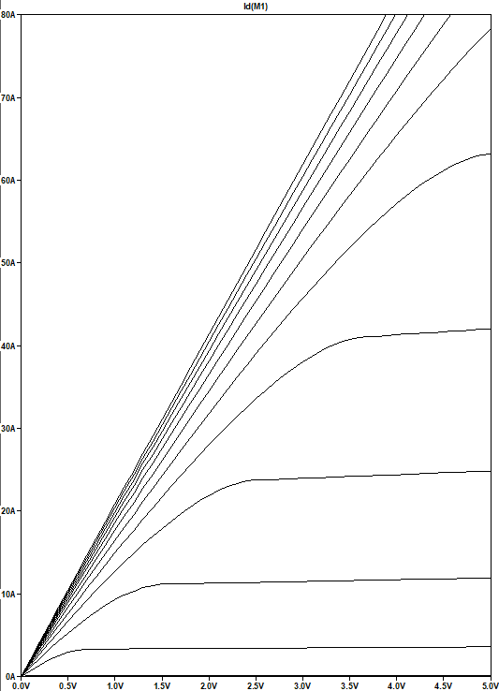
1
Output characteristics

Slide 15
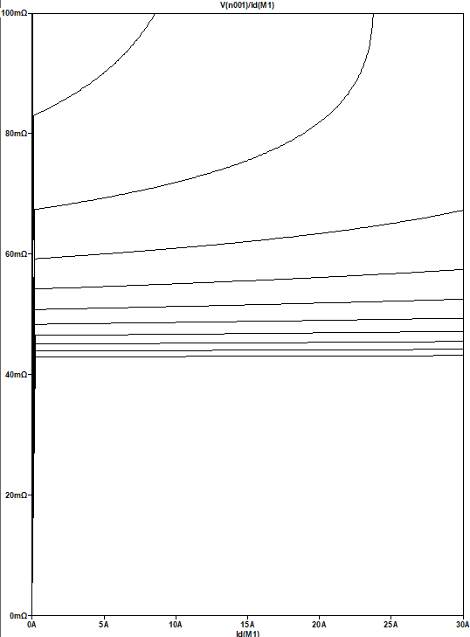
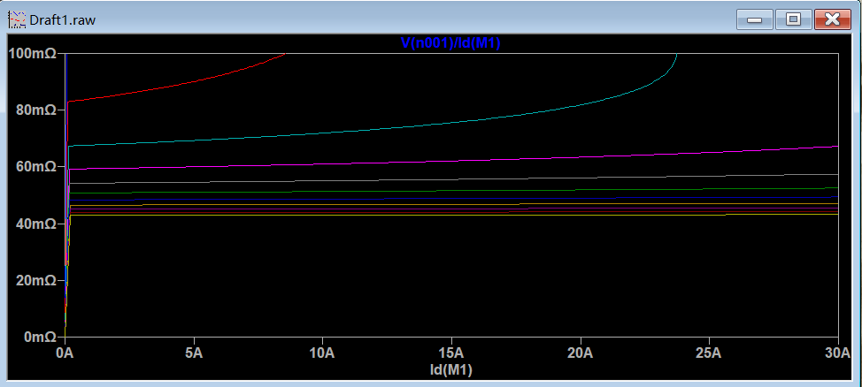
2
Drain-source on resistance

Slide 16
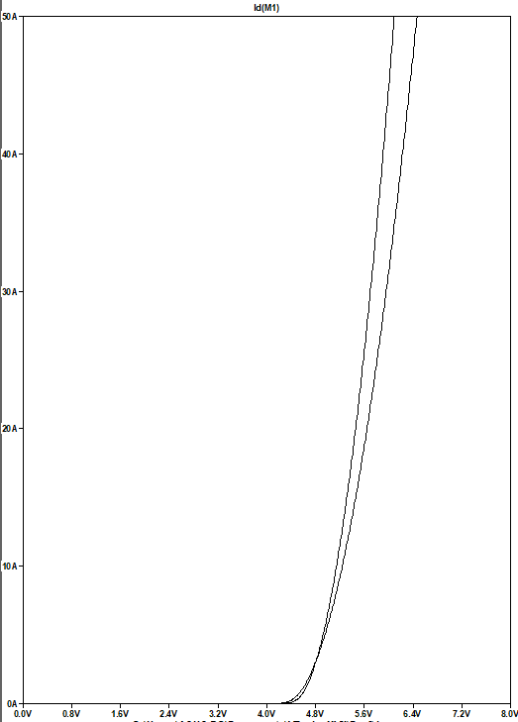
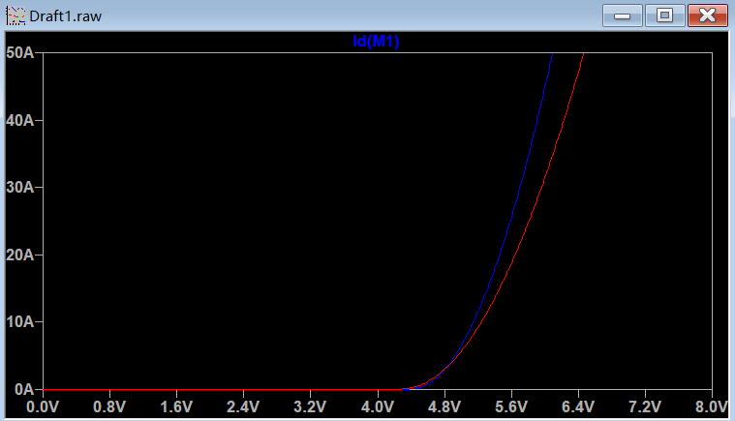
3
Transfer characteristics

Slide 17
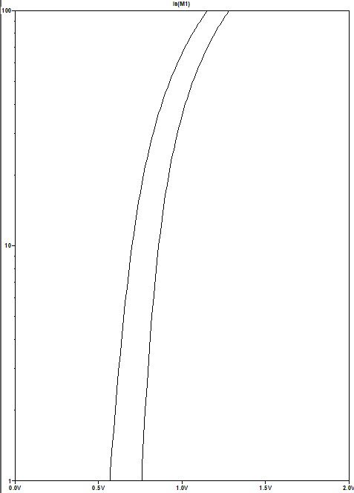
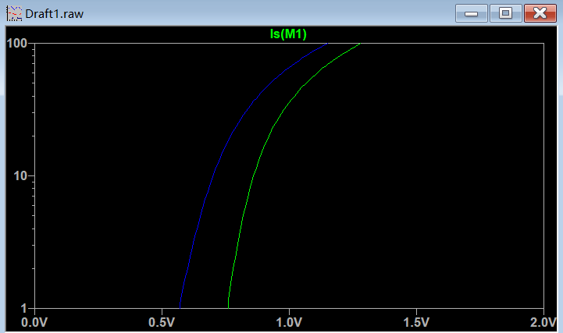
4
Forward characteristics of reverse diode

Slide 18
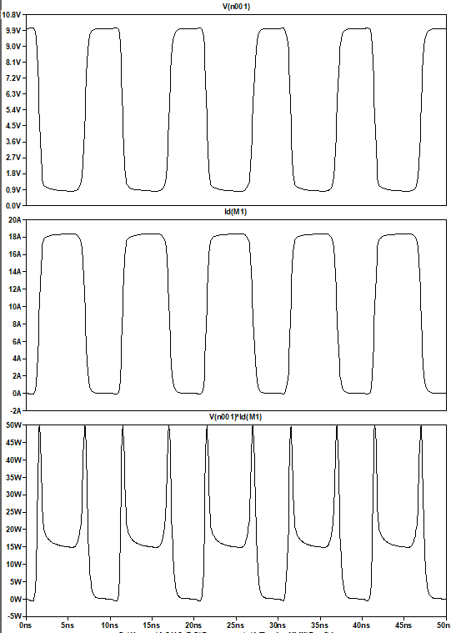
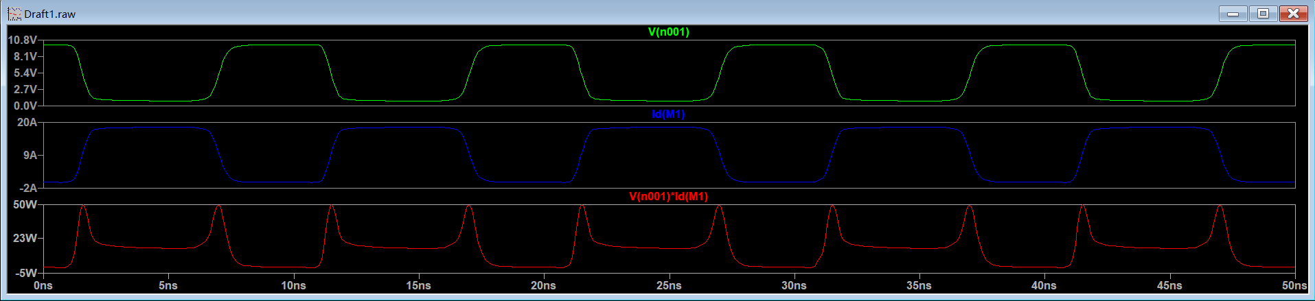
5
Switching waveform

Slide 19
04
Analysis of the Results

Slide 20
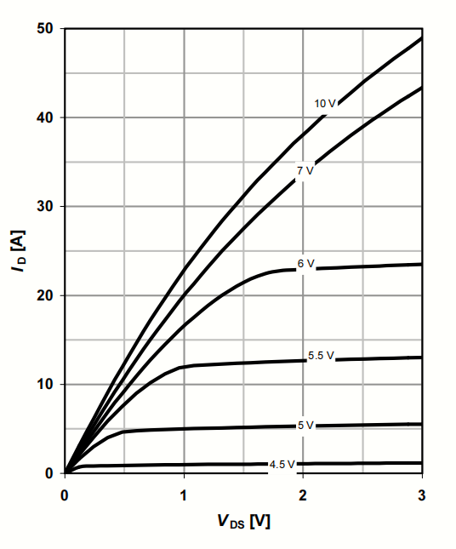
1
Output characteristics
Compared with the output characteristics given by datasheet, the images are approximately identical.
When the VGS is bigger than 4.5V, the larger the VGS, the larger the I_{D}, and tend to saturation with the increase of VDS.

Slide 21
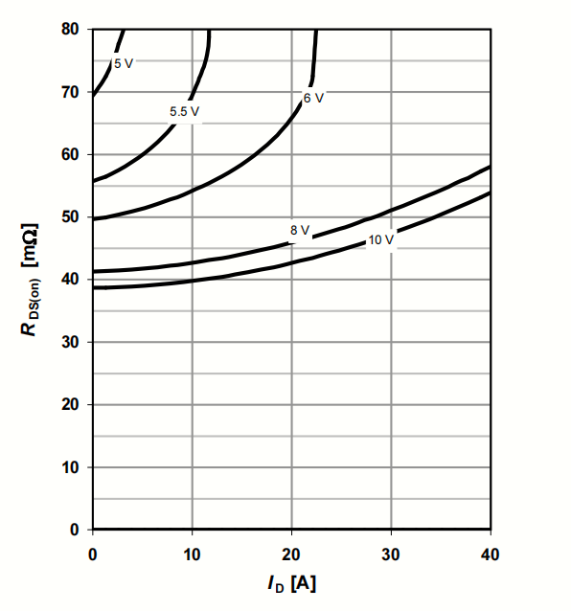
2
Drain-source on resistance
Compared with drain-source on resistance given by datasheet, the images are approximately identical.
R_{DS(on)} decreases with the increase of VGS, and increases with the increase of I_{D}.

Slide 22
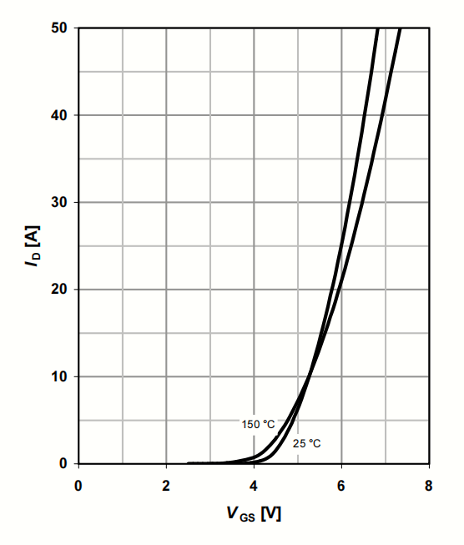
3
Transfer characteristics
Compared with transfer characteristics given by datasheet, the images are approximately identical.
The higher the temperature is, the smaller the voltage required for MOSFET conduction.

Slide 23
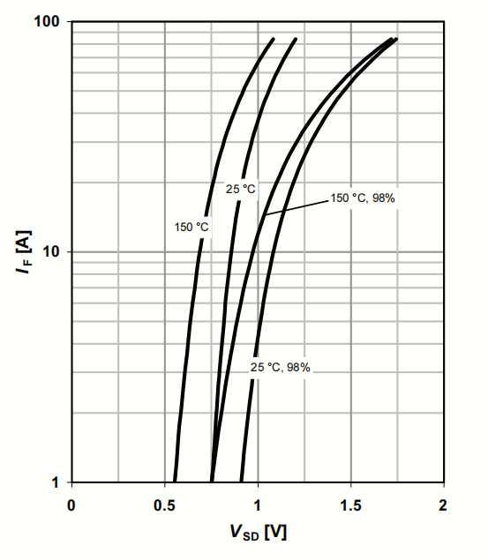
4
Forward characteristics of reverse diode
Compared with transfer characteristics given by datasheet, the images are approximately identical.
The I_{F} of reverse diode increases with temperature and tends to saturation with the increase of VSD.

Slide 24
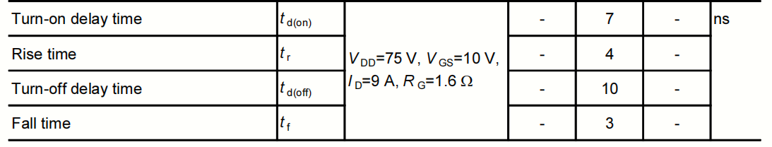
5
Switching waveform
The transmission delay of MOSFET BSC520N15NS3 is nanosecond. Since the period of VGS is also nanosecond, the waveform will show the charging and discharging process of interelectrode capacitance, so the waveform is not regular square wave.

Slide 25
Thank you

